Slide 1

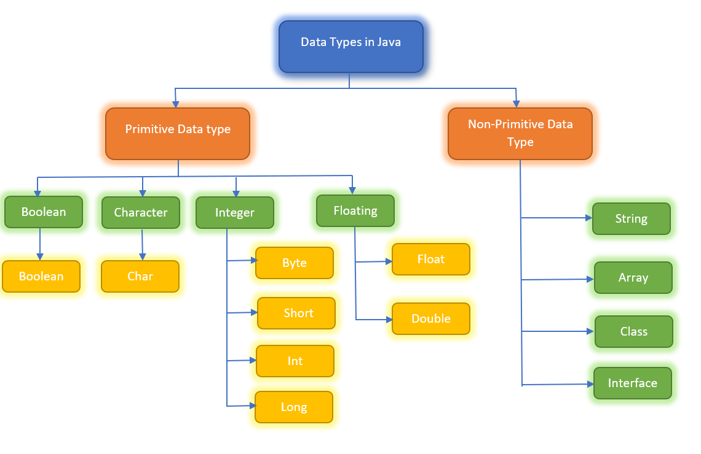

Slide 2
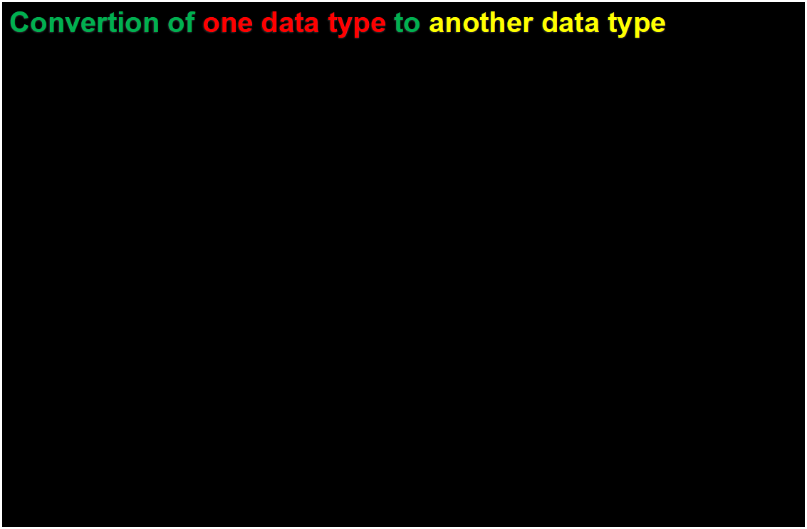
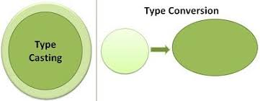
Source Type
Destination Type

Slide 3
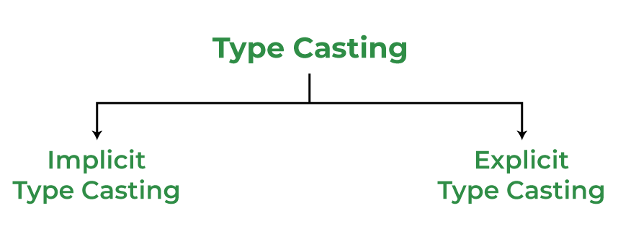
Widening Type Casting
Narrow Type Casting

Slide 5
The target type must be larger than the source type.
Both data types must be compatible with each other.

Slide 6
Implicit & Widening Type Casting

Slide 7
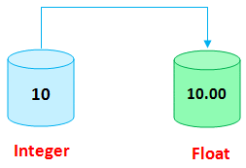

Slide 8
Explicit & Narrowing Type Casting

